Slide 1
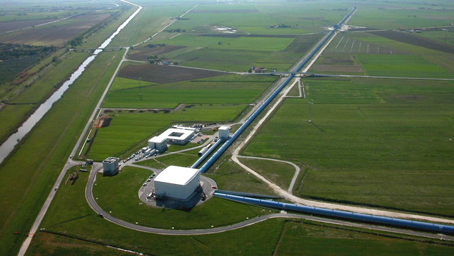


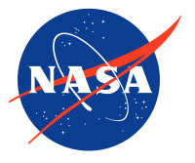
Improving the Detection of Core-Collapse Supernova Through developing an injection system for high frequency events
Presenter: Skylar Kemper
Mentor: Dr. Michele Zanolin (Department of Astronomy and Physics) Embry-Riddle Aeronautical University
Acknowledgments: Dr. Anne Boettcher, Travis Hansen, and Joshua Freed

Slide 2
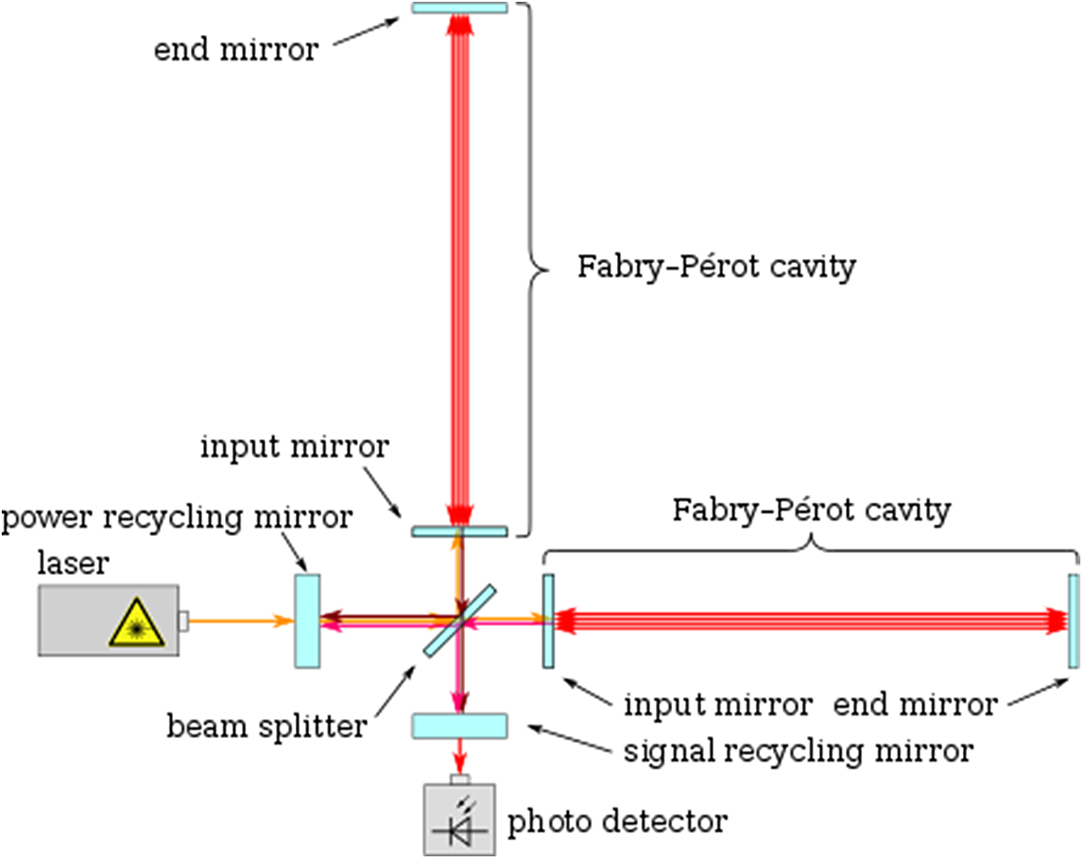

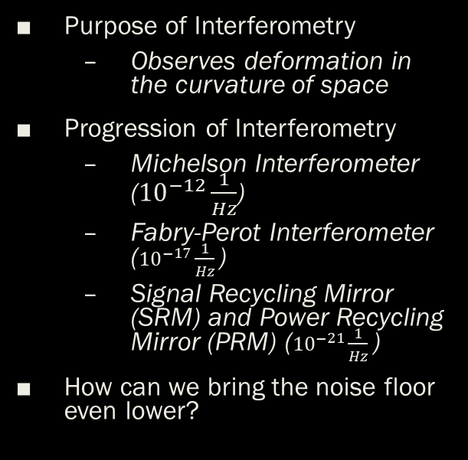
Laser Interferometer Gravitational Wave Observatories (LIGO)
Purpose of Interferometry
Observes deformation in the curvature of space
Progression of Interferometry
Michelson Interferometer (${10}^{−12}\frac{1}{Hz}$)
Fabry-Perot Interferometer (${10}^{−17}\frac{1}{Hz}$)
Signal Recycling Mirror (SRM) and Power Recycling Mirror (PRM) (${10}^{−21}\frac{1}{Hz}$)
How can we bring the noise floor even lower?

Slide 3
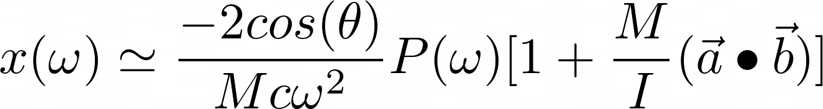

Photon Calibrator
Hardware Injections
Low frequency signals
The higher the frequency, the worse the capability to inject a signal
Designed for detections up to 100Hz
Supernova go to 1000Hz and above

Slide 4
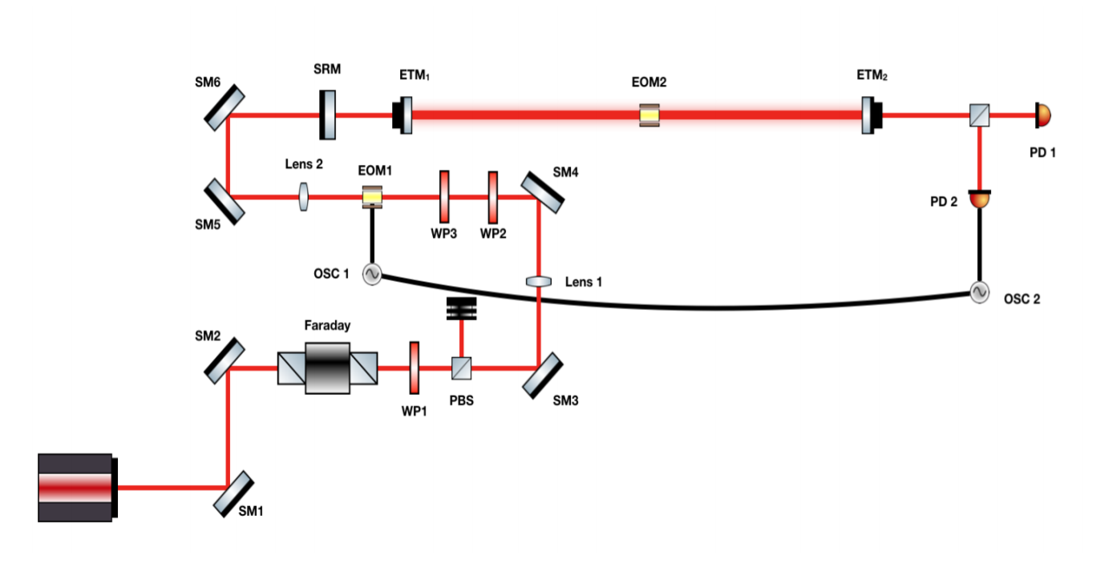
New Design for Injection System
Purpose is to improve the injection system for high frequency events
Develop a single recycle Fabry-Perot with a working high frequency injection system
Electro-Optical Modulator (EOM)
Transform signal to wave-form
Find the optimal configuration for lowering the noise floor on high frequency events
Supernova

Slide 6
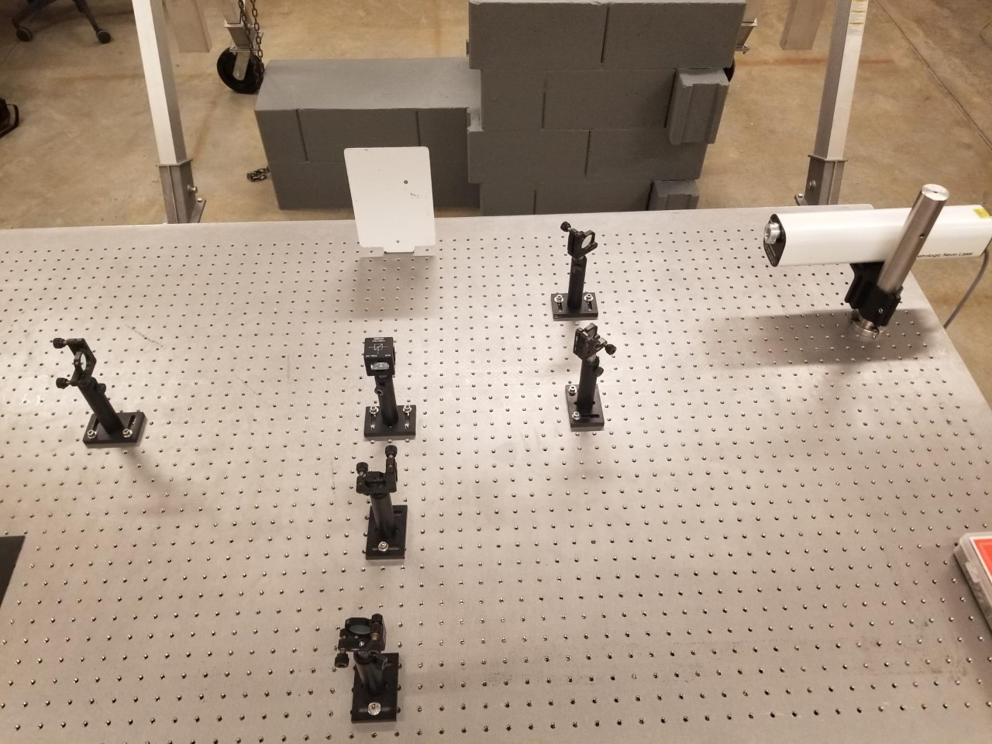
Set-Up and Future Plans
Develop an experimental Single-Recycle Fabry-Perot with a solid-state laser and EOM
Develop a secondary cavity for the Fabry-Perot
Test the noise floor

Slide 7
References
Bhattacharjee, Dripta, et al. “The September LIGO-Virgo-KAGRA Collaboration Meeting.” LIGO Database, Photon Calibrator - Status Update, 2020, pp. 1–13.
“Free-Space Electro-Optic Modulators.” Thorlabs, Thorlabs, 2020.
Hansen, Travis. “Prospects For Improving The Detection Of Core-Collapse Supernovae Through Experiment and Data Science.” Embry-Riddle Aeronautical University, 2019.
Kolata, James. “The LIGO Project.” Morgan & Claypool Publishers, 2019, p. 8-5.

Slide 8

Thank you
Questions?
kempers@my.erau.edu

